Slide 1
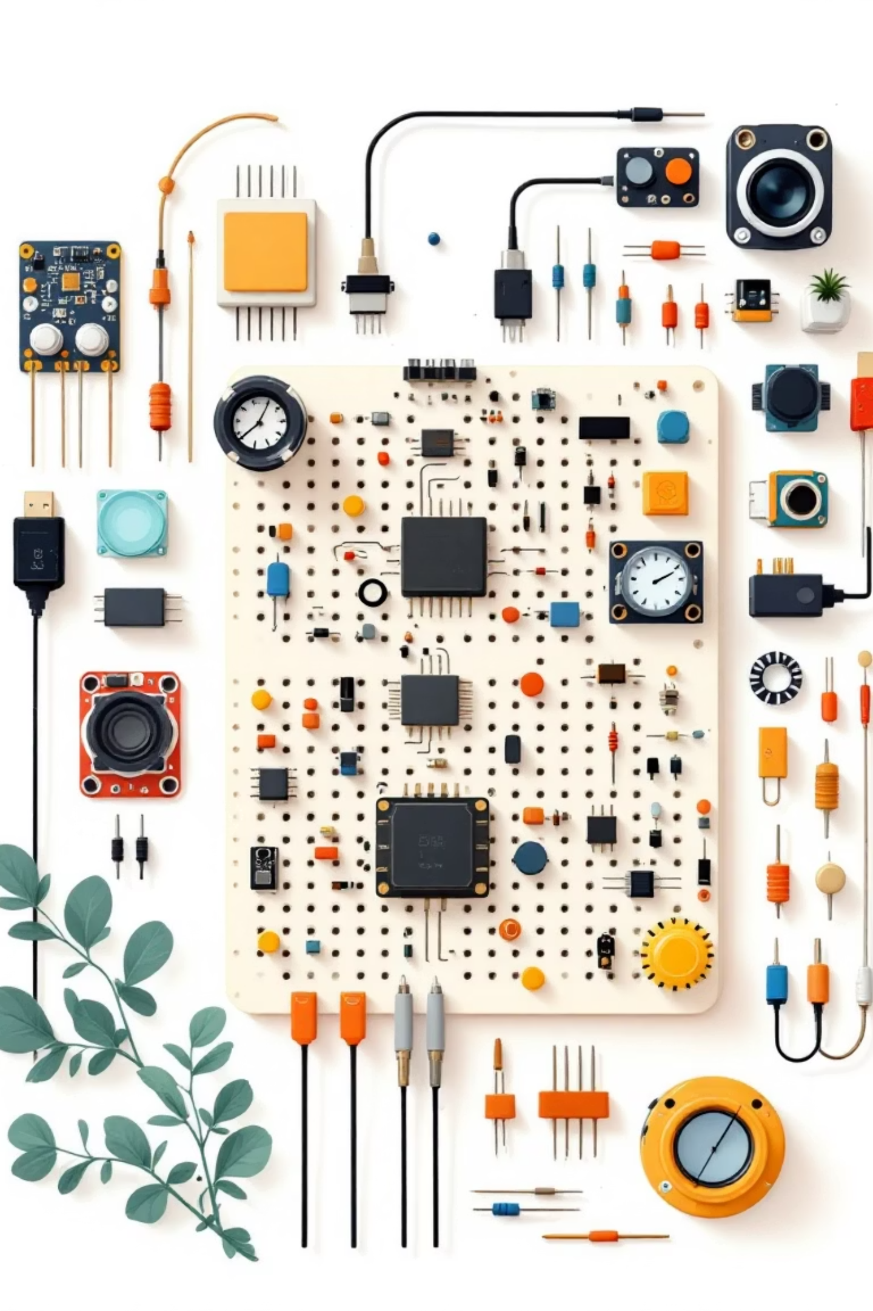
Amazing Electronic Components
Welcome to the exciting world of electronics! Today we'll discover how simple components work together to create incredible inventions.

Slide 2
Our Learning Adventure Today
1
Meet our electronic friends
2
Build a glowing LED circuit
Discover 5 essential components that make electronics work
Create your first working circuit that lights up
3
Become circuit detectives
4
Explore real-world connections
Learn to troubleshoot and fix common problems
See how electronics power our everyday world

Slide 3
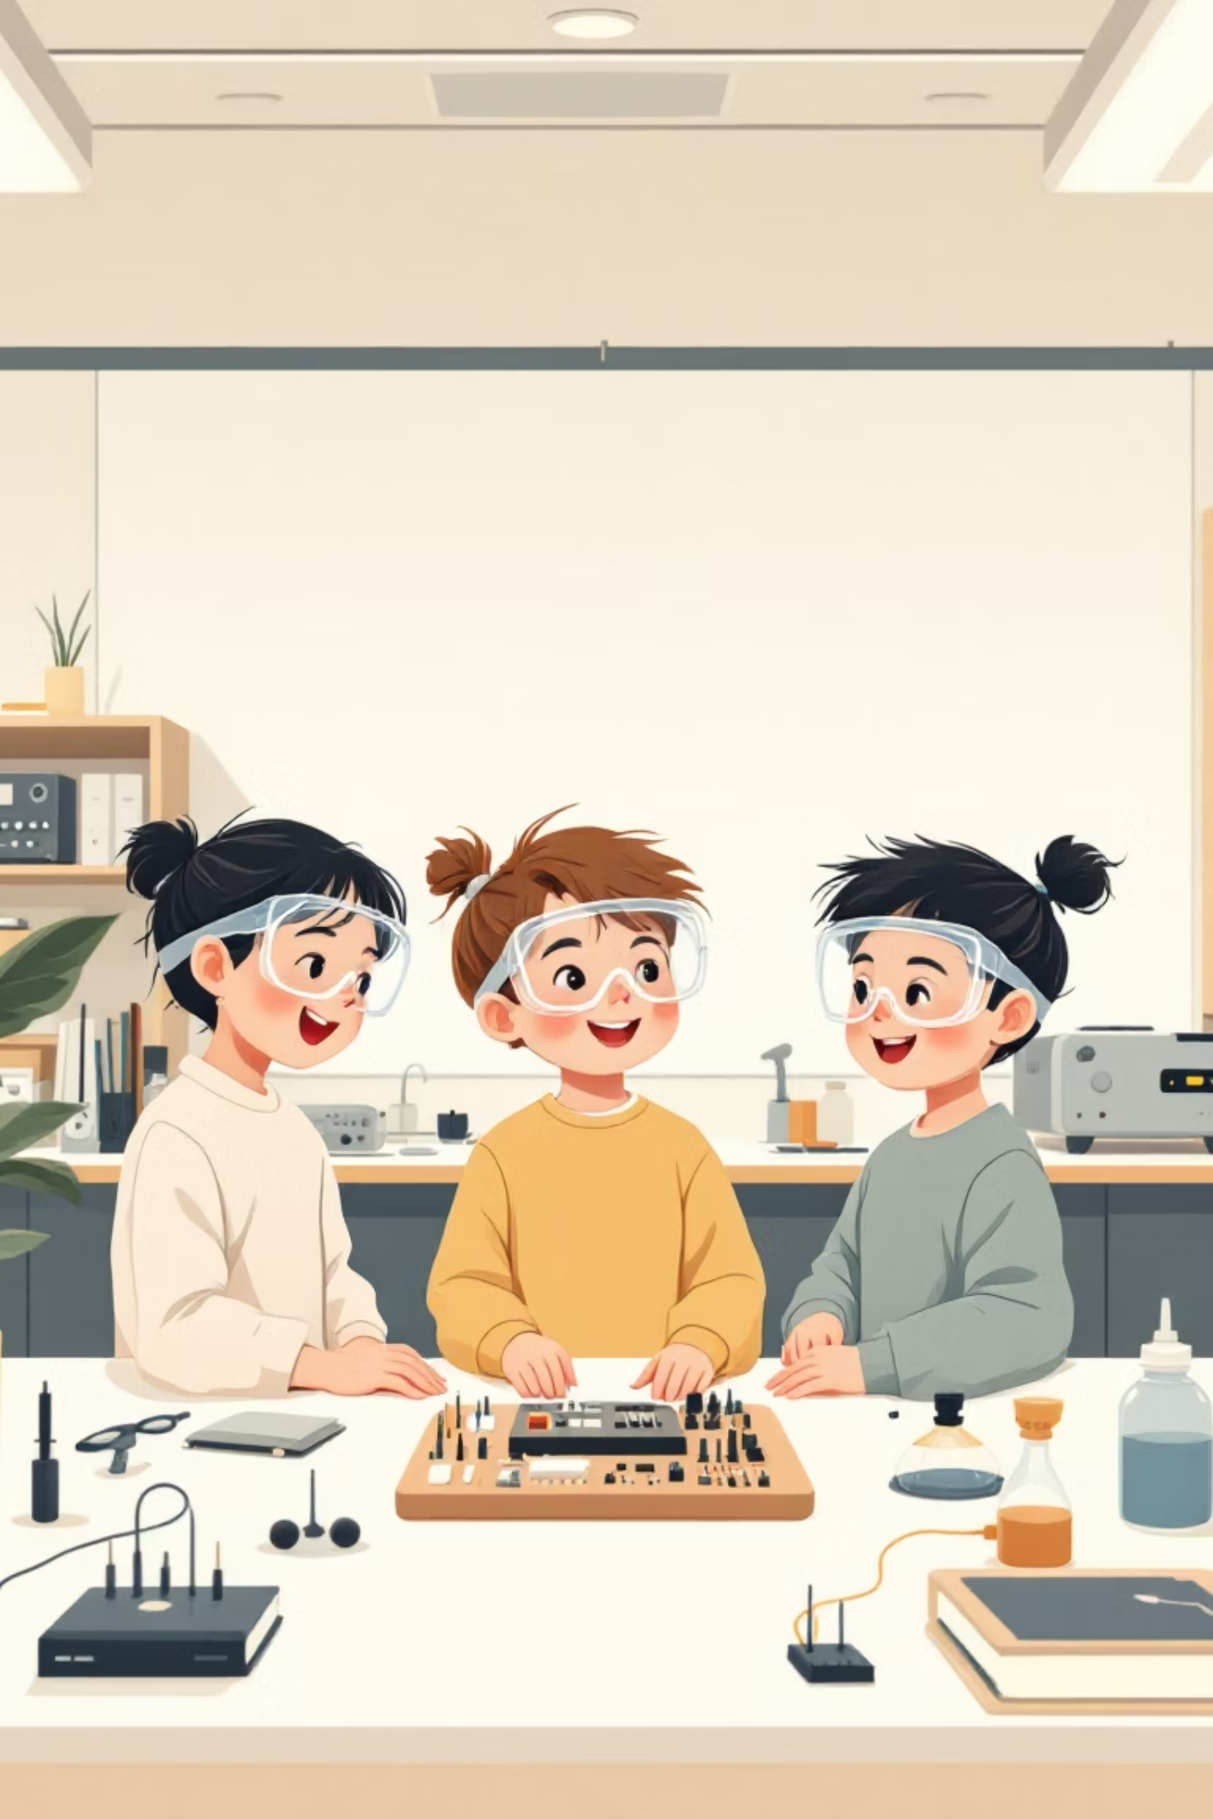



Super Engineer Safety Rules
Protect Your Super Vision
Gentle Giant Hands
Handle components carefully - they're delicate friends
Always wear safety goggles when building circuits
Tidy Workspace Heroes
Keep your building area organized and clutter-free

Slide 4

What is Electronics?
Think of electronics like LEGO blocks!
Just like LEGO pieces snap together to build amazing creations, electronic components connect to make incredible inventions. Each piece has a special job, and when they work together - magic happens!
Electronics control everything from your favorite video games to the lights in your classroom.

Slide 5





Meet Your Electronic Team
Breadboard
LED Lights
Resistor
The building platform where all components live and connect together
Tiny colorful lights that glow when electricity flows through them
The traffic controller that slows down electricity to keep LEDs safe
Jumper Wires
Potentiometer
Colorful highways that carry electricity between components
The volume control that lets you adjust how bright your LED shines

Slide 6
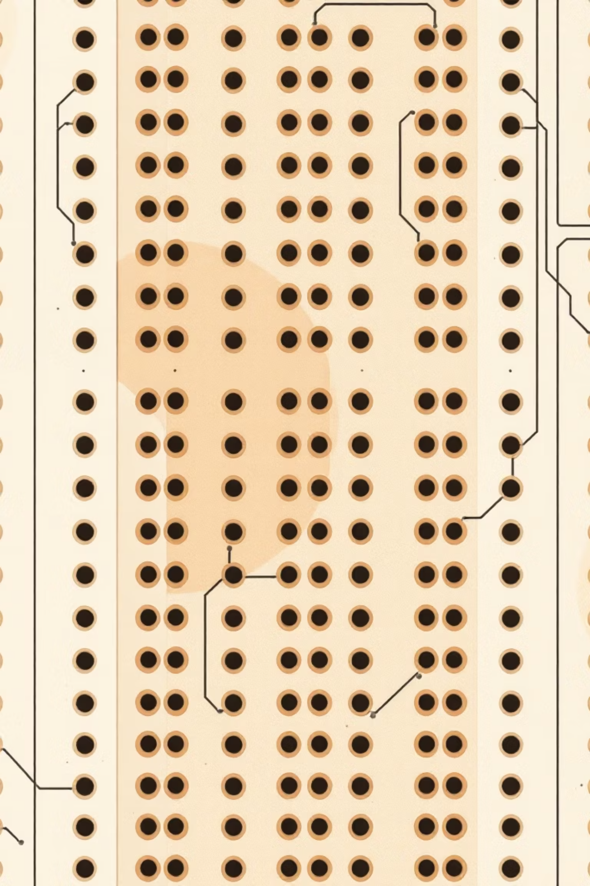
Breadboard: Your Building Platform
Fun Fact: Named After Bread!
How It Works
The breadboard has hundreds of tiny holes connected in rows. Components plug into these holes to create electrical connections - no tools needed!
Long ago, inventors actually used wooden breadboards from kitchens to build circuits. Today's plastic versions are much better!

Slide 7
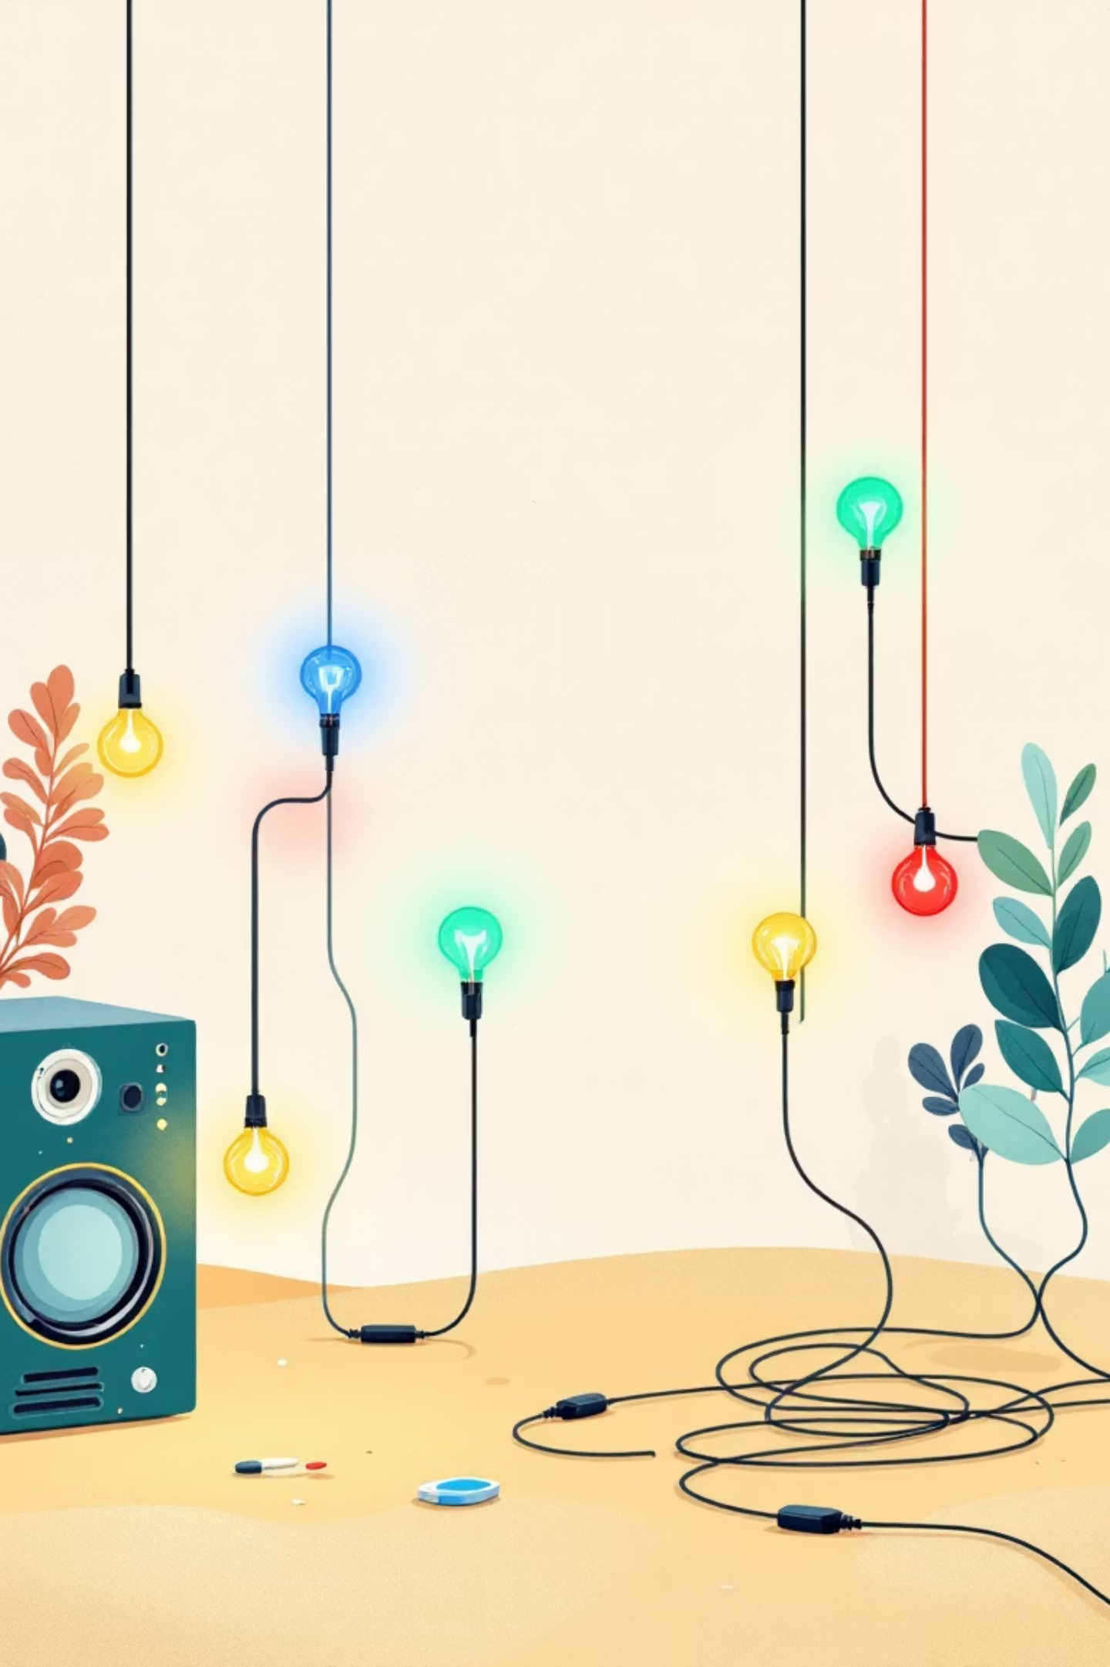

LEDs: Happy Little Lights
Red LEDs
Perfect for stop signs and warning lights
Green LEDs
Great for "go" signals and nature projects
Blue LEDs
Cool and modern, like ocean waves
Yellow LEDs
Bright like sunshine and school buses
Important: LEDs have a long leg (positive) and short leg (negative) - just like magnets, they only work one way!

Slide 8

Resistors: The Traffic Controllers
What Do They Do?
Color Code Secret
Resistors slow down electricity like speed bumps slow down cars. Without them, LEDs would get too much power and burn out!
Those colorful stripes aren't just pretty - they're a secret code that tells engineers how much the resistor slows down electricity!
Our 10K resistor is perfect for protecting LEDs in beginner circuits.
Don't worry about memorizing it yet - just know that colors have meaning in electronics.

Slide 9
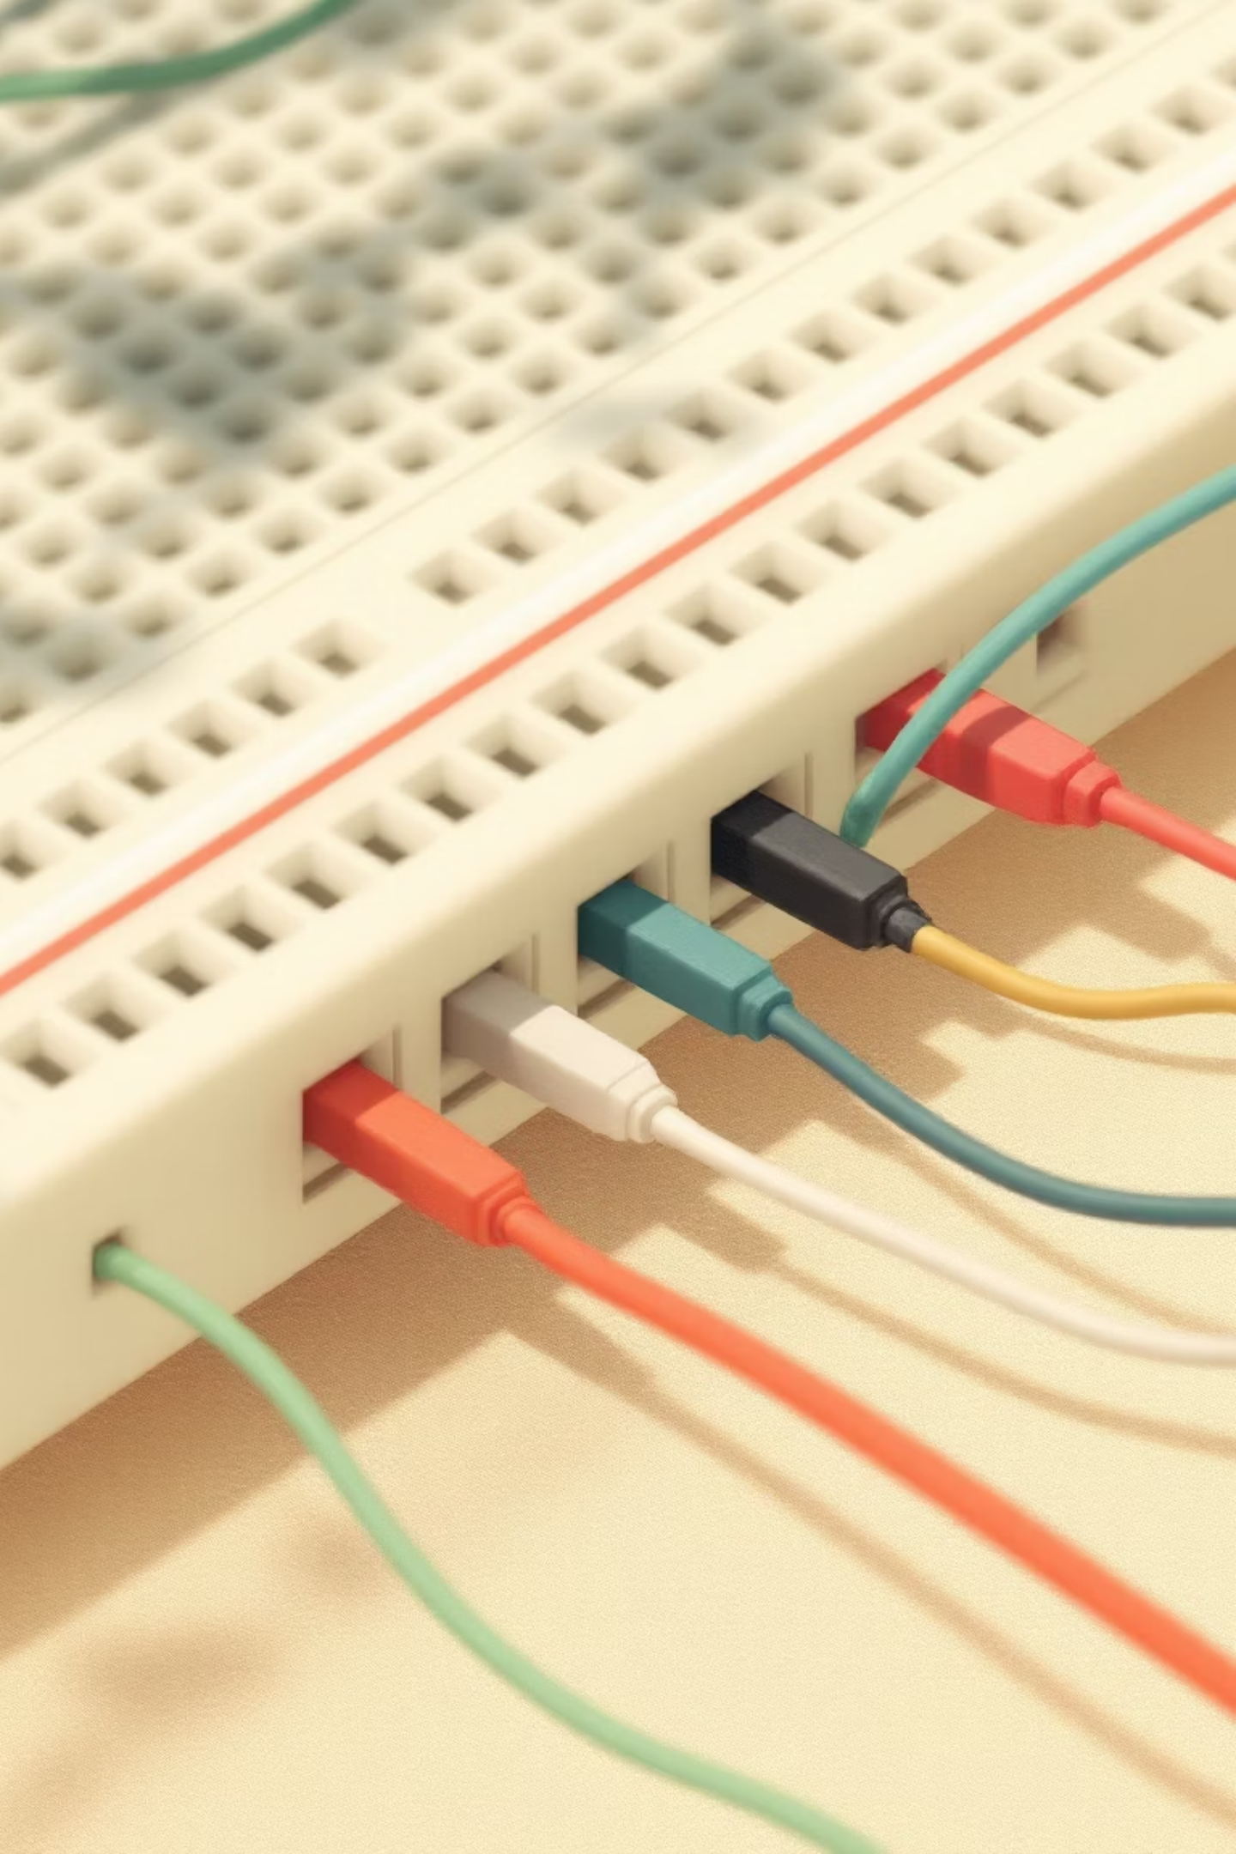
Jumper Wires: Electricity Highways
Red Wires
Black Wires
Usually carry positive (+) electricity - like the "hot" lane on a highway
Typically carry negative (-) electricity - the return path back home
Other Colors
Green, blue, yellow wires can carry signals between components
Think of jumper wires as bridges that connect different parts of your circuit city!

Slide 10
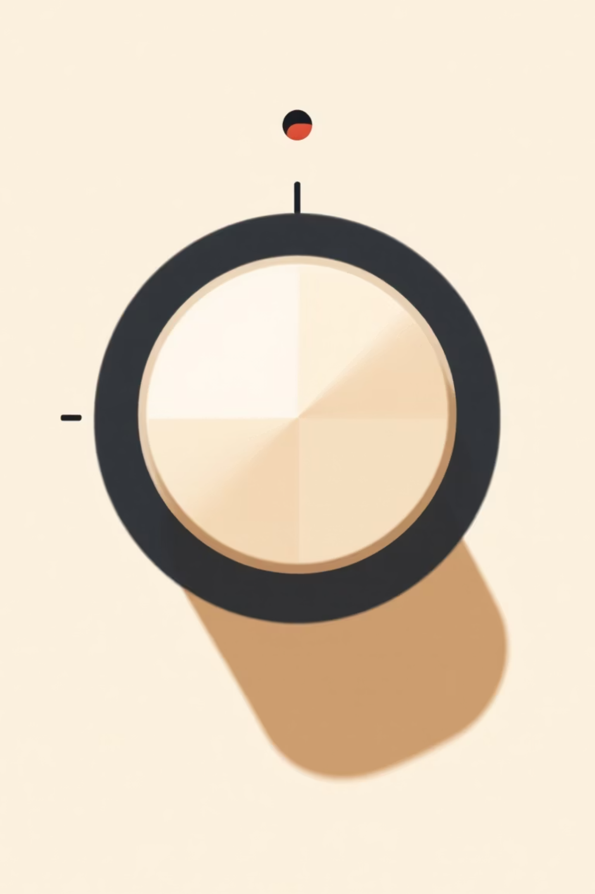


Potentiometer: Your Volume Control
Turn Left
Less electricity flows through - LED gets dimmer
Turn Right
More electricity flows through - LED gets brighter
Just like the volume knob on a radio controls sound, a potentiometer controls how much electricity flows to your LED. It's like having a dimmer switch for your lights at home!

